Slide 1
309: Prescription Drug Abuse

Slide 2
Learning Objectives
Participants will be able to:
  Associate the history of prescription drug use in America with the current trend of prescription drug abuse;
  Differentiate between the three most commonly abused types of prescription drugs;
  Identify common behaviors associated with prescription drug abuse;
  Discuss various modalities used for prescription drug abuse treatment;
  Discuss relevant laws and regulations related to the possession and use of prescription medications;
  Explain the essential elements of cross-system collaboration; and
  Demonstrate skills associated with Motivational Interviewing and the Stages of Change Model.

Slide 3
Day 1 Agenda
Section I:
Introductions and Workshop Overview
Section II:
Statistics, Facts and Trends
Section III:
Prescription Drug Scheduling
Section IV:
Stimulants
Section V:
Central Nervous System Depressants
Section VI:
Opioids
Section VII:
Summary

Slide 4
Day 2 Agenda
Section VIII:
Questions and Review of Day 1
Section IX:
Understanding and Collaborating with Medical and Law Enforcement Professionals
Section X:
Prescription Drug Abuse in Relation to the CPSL, Risk Assessment and Safety Assessment
Section XI:
Engaging Substance Addicted Clients
Section XII:
Summary and Evaluation

Slide 5
Prescription Drug Abuse
“The use of a prescription medication in a way not intended by the prescribing doctor. Prescription drug abuse includes everything from taking a friend's prescription painkiller for your backache to snorting ground-up pills to get high.”
-The Mayo Clinic (2011)

Slide 6
Prescription Drug Abuse Fact Sheet
In 2009, nearly 7 million Americans abused prescription drugs—more than the number who are abusing Cocaine, Heroin, hallucinogens, Ecstasy and inhalants combined.
Prescription pain relievers are new drug users’ drug of choice, vs. marijuana or cocaine.
Opioid painkillers now cause more drug overdose deaths than cocaine and heroin combined.
Nearly 1 in 10 high school seniors admits to abusing powerful prescription painkillers.
40 percent of teens and an almost equal number of their parents think abusing prescription painkillers is safer than abusing "street" drugs.

Slide 7
Prescription Drug Abuse Fact Sheet (cont.)
Hydrocodone is the most commonly abused controlled pharmaceutical in the U.S.
Twenty-five percent of drug-related emergency department visits are associated with abuse of prescription drugs.
Methods of acquiring prescription drugs for abuse include “doctor-shopping,” traditional drug-dealing, theft from pharmacies or homes, illicitly acquiring prescription drugs via the Internet, and from friends or relatives.

Slide 8
Prescription Drug Abuse Fact Sheet (cont.)
Doctor involvement in illegal drug activity is rare—less than one tenth of one percent of more than 750,000 doctors are the subject of DEA investigations each year—but egregious drug violations by practitioners unfortunately do sometimes occur. DEA pursues criminal action against such practitioners.
DEA Internet drug trafficking initiatives over the past 3 years have identified and dismantled organizations based both in the U.S. and overseas, and arrested dozens of conspirators.
Because of major investigations, tens of millions of dosage units of prescription drugs and tens of millions of dollars in assets have been seized.
-U.S. Drug Enforcement Administration (2009)

Slide 9

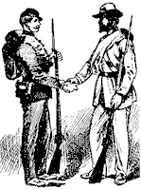
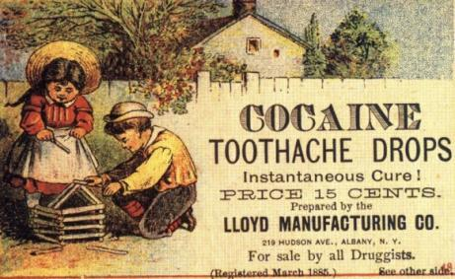
Prescription Drug Abuse Timeline
1850 – 1900

Slide 10
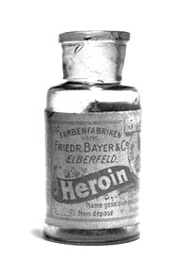
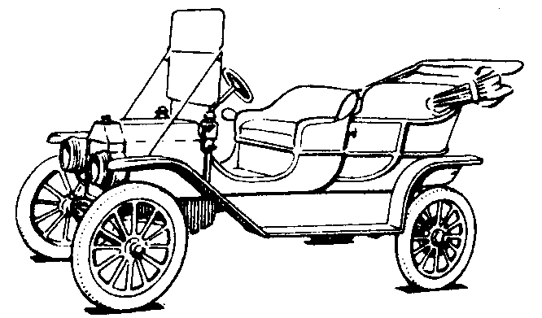
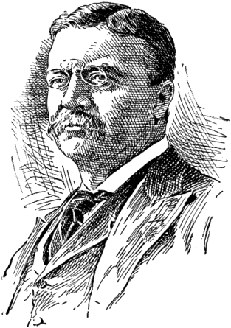
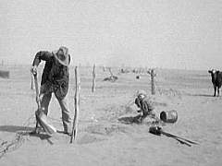
Prescription Drug Abuse Timeline, (cont’d)
1900 – 1950

Slide 11


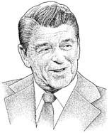

Prescription Drug Abuse Timeline, (cont’d)
1950 – 2000

Slide 12



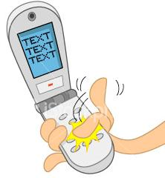

Prescription Drug Abuse Timeline, (cont’d)
2000 – 2011

Slide 13
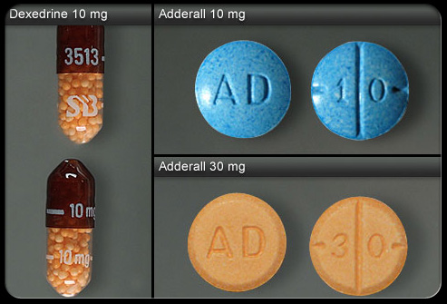
Stimulants

Slide 14
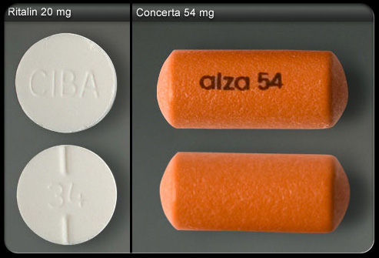
Stimulants, (cont’d)

Slide 15
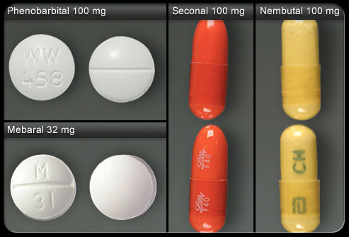
CNS Depressants (Barbiturate)

Slide 16
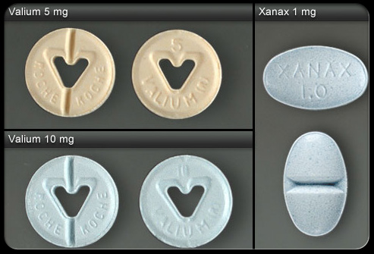
CNS Depressant (Benzodiazepine)

Slide 17
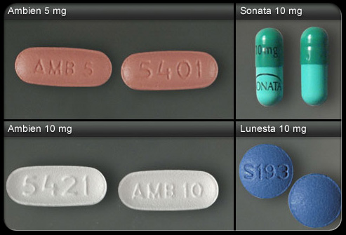
CNS Depressant (Sleep Aids)

Slide 18
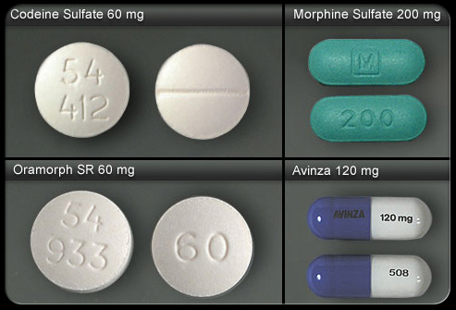
Opioids

Slide 19
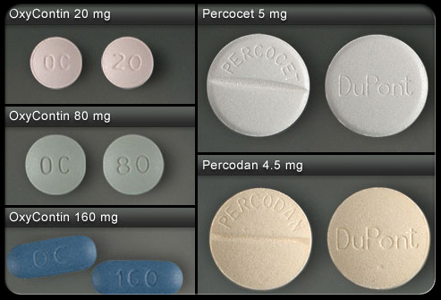
Opioids, (cont’d)

Slide 20
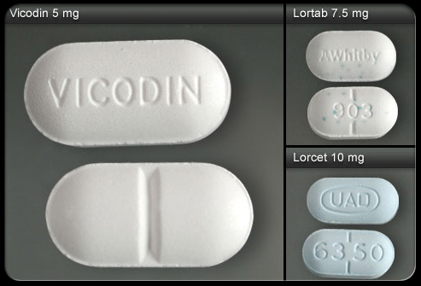
Opioids, (cont’d)

Slide 21
Status of State Prescription Drug Monitoring Programs (PDMPs)

Slide 22

Essential Elements of Successful Collaboration
Recognition and Definition;
Clear, Concrete Goals;
Effective Informal Relationships;
Policies and Procedures;

Slide 23
Essential Elements of Successful Collaboration, (cont’d)
Training;
Collaboration Must be Perceived as Mutually Beneficial;
Shared Responsibility; and
Coordination.
-Robinson, Rosenberg, Teel, Stainback-Tracy (2003)

Slide 24
“When the only tool you have is a hammer, everything looks like a nail.”

Slide 25

Motivational Interviewing
Open Ended Questions;
Affirmations;
Reflective Listening; and
Summaries.

Slide 26
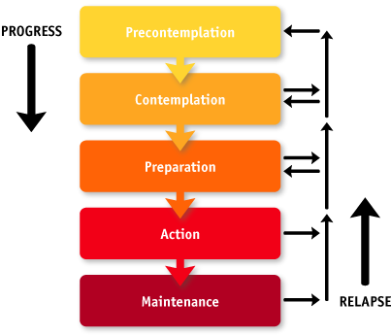
The Stages of Change

